Slide 1
Machine Learning Fundamentals: Capstone Project (Operation Epic Failure)
Machine Learning Fundamentals
Richard Boulet
6/16/2019

Slide 2
Table of Contents

Slide 3
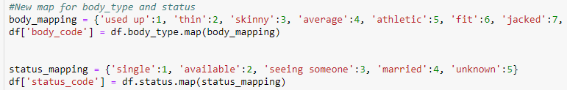
Data exploration
First began by looking at all the unique values within 6 data columns
Age
Drinks (drinks codes)
Body type
Status
Average word length
Essay length
Next, began mapping the body types and status types qualitative descriptors to quantitative values
Added these two new data columns to the master dataframe

Slide 4
Data exploration Continued
Dropped Nan from all rows
Next, worked on exploring the data graphically
Graphed histograms of following to see the frequency of appearance:
Body Types
Drinking Amounts
Status
Average Word Length
Essay Lengths

Slide 5
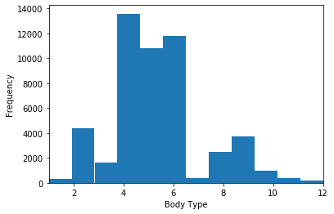
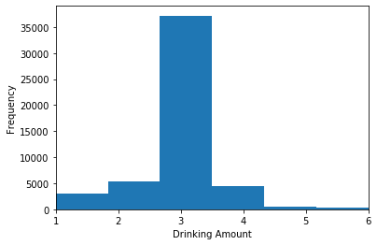
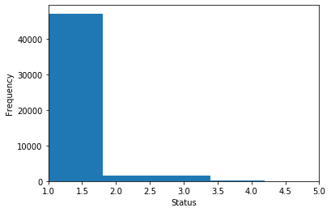
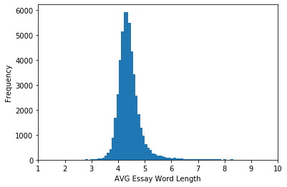
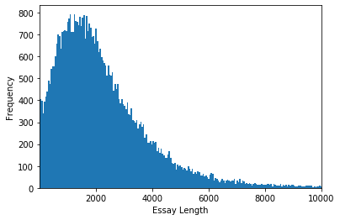

Slide 6
Data exploration Continued
Next, created a new metric DrinkWeight that ideally showed a higher value given body Type increase and drinking level increase
Plotted additional graphs of:
The DrinkWeight by Age
The Body Type by Age
The essay length and average word length compared to age (landscape 3D graph)
The essay length and average word length compared to age (Scatter Plot 3D graph)

Slide 7
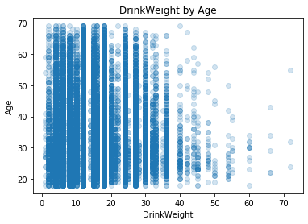
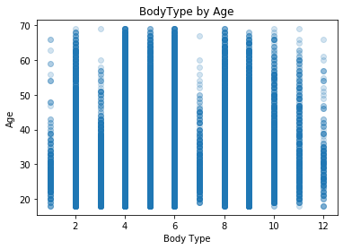
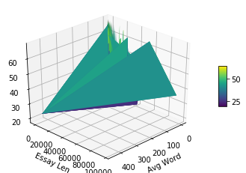
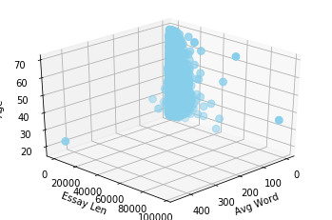

Slide 8
Questions
Can we predict age based on body_type and drinkweight?
(columns: age, body_type, drink_weight)
Can we predict status based on avg word length and essay length?
(columns: status, average_word_length, essay_len)
I believe one of the issues I came across was that Status had mostly ‘singles’ as the target, and it was difficult to create a classifier that could predict other statuses.
Additionally, when I tried to transform inverse the predictions for age I kept running into 1D vs 2D array issues for the transformation to occur. My predictions for this data set were wildly lower, or I missed the fact of multiplying them by a value to adjust the predictions.
Not sure if either of these is true or if I was missing a major point to applying these models given the data ranges.

Slide 9
Classification Techniques - SVM
Support Vector Machine Classification
I found this to be fairly simple to implement, but not sure if using this with the kernel set at ‘rbf’ was the best approach. I also tried linear.
Run time was slower setting the cache at 500, and lowered it to 200 after.
My predicted values came out to realistic values (ages were within the Age data range, and status codes showed mostly singles).
Performance
For Classifying Age, the model accuracy was very poor at .06, the precision was very poor (.002) showing large amounts of false positives?, and the recall was Very Poor (.018) showing large amounts of mislabeled target data points.
For Classifying Status, the model accuracy was very high at .93, the precision was Poor (.18) showing large amounts of false positives, and the recall was Poor ( .20) showing large amounts of mislabeled target data points.
I think that given the y predicted values were coming out within a reasonable range, but still getting a “precison and F-score” ill defined, I made a mistake with my labels? Or my implementation of the data minmaxs caling??

Slide 10
Classification Techniques - KNearest
Knearest Classification
I found this to be very simple to implement (if I did it correctly)
My predicted values came out to Unrealistic values (ages were predicted to be all near 1)
The run time for this model was very quick compared to SVM
Performance
For Classifying Age, the model accuracy was Very Poor at .00, the precision was very Very poor (.00) showing large amounts of false positives?, and the recall was Very Very Poor (.00) showing large amounts of mislabeled target data points.
For Classifying Status, the model accuracy was Very High again at .924, the precision was Poor (.23) showing large amounts of false positives, and the recall was Poor ( .20) showing large amounts of mislabeled target data points.
Again got errors on “precision and f-score ill-defined” there was either a fundamental issue trying to fit these models to age and status using the independent variables I did use, or an error in syntax? Or missed a transformation step altogether given that the small integer range for drinks codes and status?

Slide 11
Regression Techniques – Linear and KNEarest
Linear Regression
I found this to be fairly easy to implement (again if I did it correctly)
I found an issue with the predicted y values for Ages, so I attempted to transform_inverse the predicted y data, but ran into issues with array reshaping (tried multiple reshaping parameters) in order to transform the predicted values to ages (again not sure if this was really necessary or a basic understanding error was made by me)
The R2 value was abysmal for linear regression model, and had a NEGATIVE??? R2 of -9.79 for estimating Age, and a very poor R2 of .01 for predicting Status.
Knearest Regressor
I found this to be fairly easy to implement (again if I did it correctly)
The R2 value was again terrible for the Knearest regression model, and had a NEGATIVE??? R2 of -10.71 for estimating Age, and an odd R2 of -.39 for predicting Status.

Slide 12
Conclusions – You CANNOT PREDICT WITH MY MODELS!
I missed a basic understanding of which models should be applied to which data sets (predicting status with mostly singles on dating app)
Even though the accuracy was very high for predicting Status, when utilized to predict other data points, the regression model was useless. You cannot predict Status given average word length and essay length.
I did learn a lot of ways to recheck errors in my code (yay!) and some libraries I was unaware of.
Overall, my models should not be used to predict age given body type and drinkweight. Better off using darts and a spinning wheel. Additionally, my models should not be used for predicting status of persons on a dating app (which I should have inherently understood would be unnecessary) given average word length and essay length.
My models continuously mislabeled predicted data points and Would like to implement the same techniques using some of the raw data points for Sepals In order to understand how to properly obtain accurate models using Python3.
An additional data set to use to improve my results may have been how inclined the individual is to mislead others about their status on the dating app.

